Slide 1
What Factors Influence Loan Approval
Exploratory Data Analysis on Loan Approval Factors
Maxim Bilenkin
Course: DSC 530, Prof. Fadi Alsaleem
02/23/2025

Slide 2
Introduction & Dataset Overview
Introduction
Understanding Loan Approval Factors
Many individuals apply for loans, yet not all are approved.
This project explores the key factors influencing loan approvals.
Dataset Overview
Size: 44,972 loan applications
Key Variables: Age, Income, Loan Amount, Credit Score, etc.
Data Cleaning: Removed extreme outliers (ages 109-144, incomes over $1M).

Slide 3
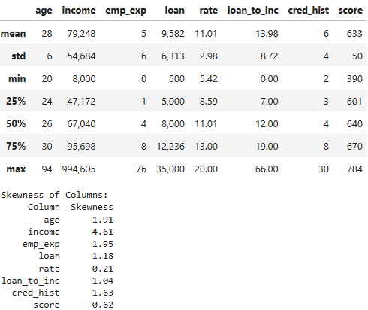
Descriptive Statistics
Overview
Descriptive statistics summarize key aspects of the dataset.
They help understand the distribution, central tendency, and variability of the data.
Key Statistics (After Data Cleaning)
Total Records: 44,972 loan applications
Mean Income: $79,248
Mean Loan Amount: $9,582
Credit Score Range: 390 – 784
Loan Interest Rate Range: 5.42% – 20.00%
Skewness Analysis
Several variables, such as income and employment experience, exhibit skewness.
Right-skewed distributions indicate the presence of extreme values affecting the mean.
Next Steps
Visualizing distributions to further explore trends in the dataset.

Slide 4
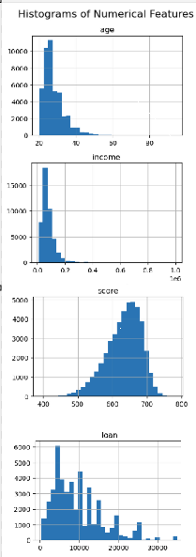
Distribution of Key Variables
Understanding Data Distribution
Visualizing distributions helps identify patterns, skewness, and outliers.
Key variables analyzed: Age, Income, Loan Amount, and Credit Score.
Findings from Histograms & PMFs
Age: Most applicants are between 24-35 years old.
Income: Right-skewed distribution; a few individuals earn significantly higher than the median.
Loan Amount: Most loans fall between $5,000 - $15,000, with fewer high-value loans.
Credit Score: Normal-like distribution, peaking around 640-680.
Next Steps
Use CDFs (Cumulative Distribution Functions) for deeper insights into variable distributions.

Slide 5
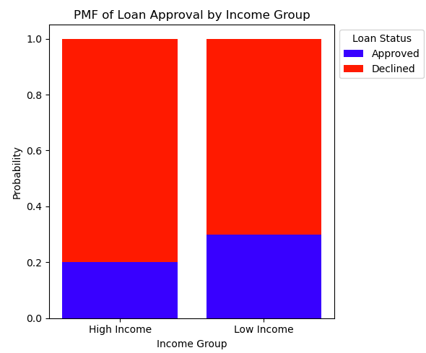
PMF Analysis of Loan Approval by Income Group
PMF shows the probability of discrete outcomes (approval/rejection) in different income groups.
Contrary to expectations, low-income applicants have a higher loan approval rate than high-income applicants.

Slide 6
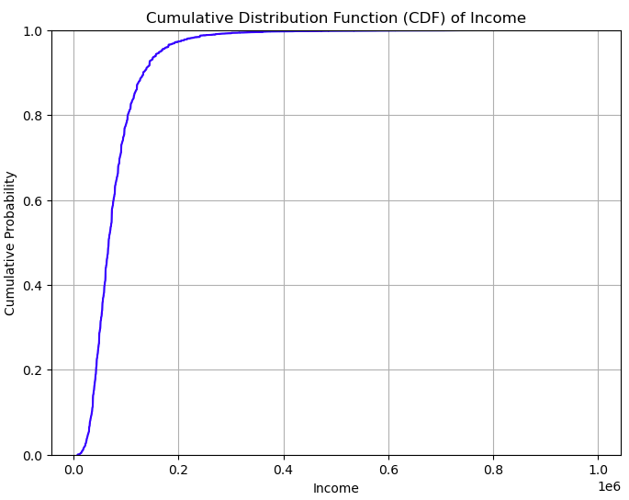
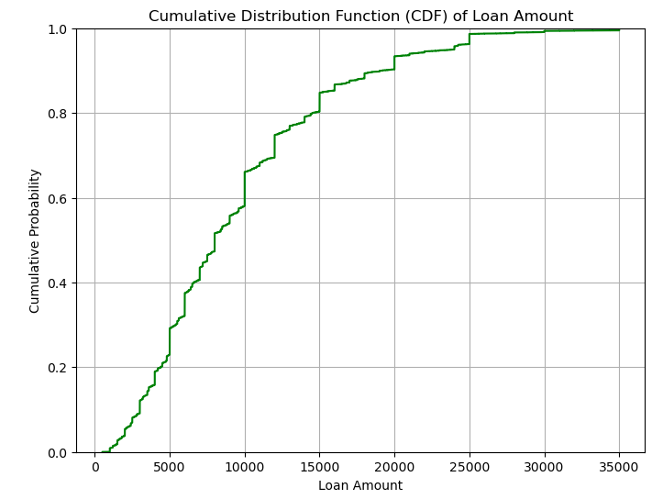
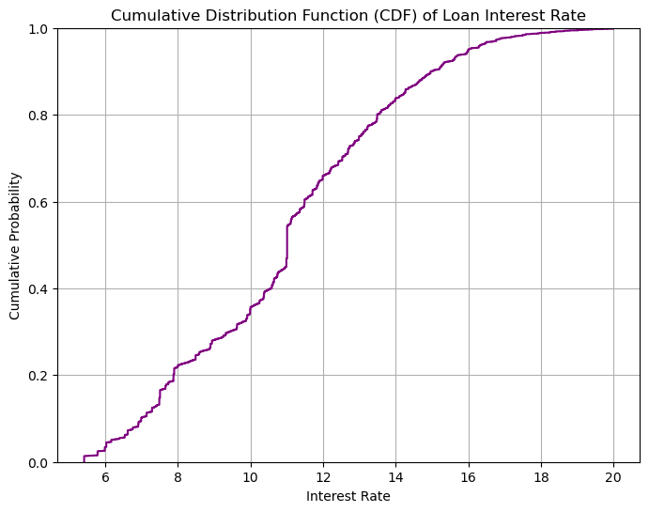
CDF Analysis of Key Variables
Why Use CDFs?
CDFs help understand the proportion of data below a given threshold.
They provide a clearer view of variable distribution compared to histograms.
Findings from CDFs
Age: Around 50% of applicants are under 30 years old.
Income: The majority earn below $100,000, but a small percentage earns significantly more.
Loan Amount: Most loans are under $15,000, with a few high-value loans affecting the distribution.
Credit Score: 75% of applicants have a credit score above 600.
Next Steps
Examine correlations between variables to identify relationships.

Slide 7
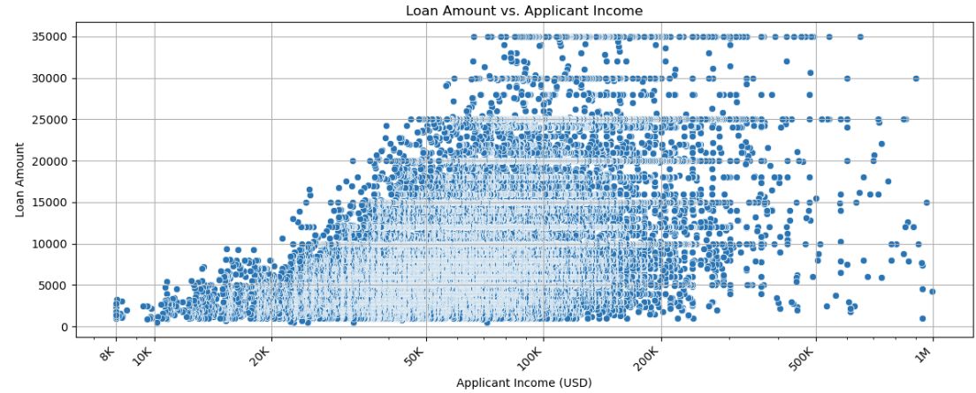
Statistical Analysis & Predictions
Scatter Plot
Brief Observations
There is a moderate positive correlation (r = 0.36) between loan amount and applicant income, meaning higher-income applicants tend to receive larger loans. This relationship is statistically significant.

Slide 8
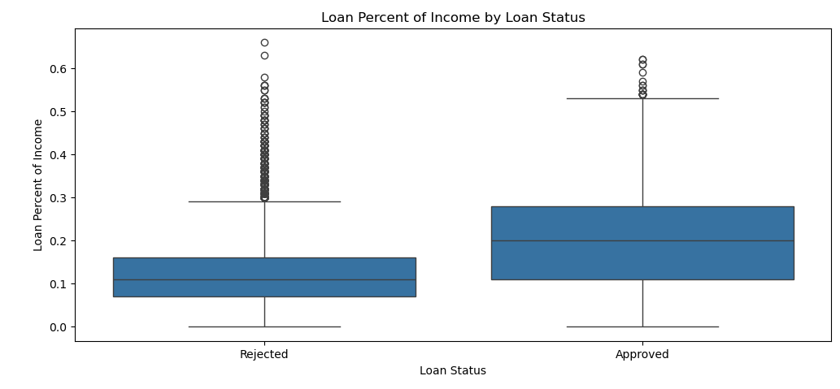
Statistical Analysis & Predictions
Box Plot
Brief Observations
There is a significant relationship between the loan amount as a percentage of income and loan status (p-value = 0.0). Higher loan percentages relative to income are associated with a higher likelihood of loan denial. Higher loan-to-income ratios show more variability among approved loans, but extremely high ratios increase the likelihood of rejection.

Slide 9
Key Findings & Insights
Loan Amount vs. Applicant Income
Income Correlation: Higher-income applicants request and receive higher loan amounts.
Correlation Coefficient: 0.36 (Statistically significant, p < 0.0001). A correlation of 0.36 indicates a moderate positive relationship - higher income tends to be associated with higher loan amounts, but other factors also play a role.
Key Insight: Higher-income applicants are more likely to be approved for larger loans.
Loan Percent of Income by Loan Status
Negative Relationship: A higher loan amount as a percentage of annual income is more likely to be rejected.
T-statistic: 88.39 (Statistically significant, p < 0.0001).
Key Insight: The ratio of the loan amount to annual income is crucial when making approval decisions. Borrowers requesting loans that are a higher percentage of their income are less likely to be approved.

Slide 10
Challenges & Limitations
Despite valuable insights, the analysis has some limitations
Most variables are positively skewed, which could impact statistical assumptions.
Patterns in the data don’t necessarily imply cause-and-effect relationships.
Hypothesis testing and regression analysis have assumptions that may not hold perfectly.
Economic conditions, policy changes, or applicant behavior could influence results.

Slide 11
Conclusions & Implications
Key Conclusions
1. Loan as a Percentage of Applicant Income
Strong Influence: Loan-to-income ratio impacts approval decisions, but there is no strict cutoff rate.
Insight: Loans with a higher percentage of income show an increasing rejection trend beyond 20-30%, but approval rates improve for applicants beyond 30-40%, suggesting other factors also play a role.
2. Loan Amount vs. Applicant Income
Positive Correlation: A clear relationship exists between applicant income and loan amount.
Insight: Higher-income applicants tend to receive higher loan amounts.
Implications
For Lenders: These key factors can help refine the loan approval process and improve decision-making.
For Borrowers: Maintaining a balanced loan-to-income ratio is beneficial, but other creditworthiness factors, such as credit score and lender policies, also affect approval.

